Slide 1
Name : BARUN KUMAR
Roll no. : 18125760015
Mid Term Report

Slide 2
Default of Credit Card Clients

Slide 3
Problem Statement
The problem finding the patterns in customer behaviors that help predicting if a customer have a chance of getting his credit card defaulted before the 6 months period. By applying the right algorithm and parameters we can get a prediction on the 5th month or even 4th month to know if the customer have high chance of getting his credit card defaulted
This research aimed at the case of customers default payments in Taiwan and compares the predictive accuracy of probability of default among six data mining methods.

Slide 4
Business Understanding
Banks consider the denial of credit applications to risky customers an important priority in order to avoid undesirable decisions and consequences, like granting a customer a credit limit increase to risky customers. For example, a customer who has skipped making the minimum payment for several months. In such case, the credit card should be set to default after the customer has failed to make a payment for 6 months in a row. A credit default is a credit status applied when a customer fails to make the minimum payment for 6 months.
Risk Management is important field in Banking, and when we are talking about credit cards, credit risk management will be the first line of defense for any credit decision. Performing credit risk management correctly allows banks to minimize the risk associated with credit cards.

Slide 5
Approach
The Goal is to train a model with the capability to minimize the risk by making predictions based on the dataset.
The model predicts whether a late-paying customer will only be late for a limited duration (1 or 2 months), or if this customer is predicted not to make a payment at all.
This makes it a classification problem.

Slide 6
Data Understanding
The dataset that will be used for this project is the “Default of Credit Card Clients Dataset.
Dataset portrays information about a bank’s credit card clients along with their marital status, their balance limit, education, when they paid respective bill amounts.
Size: 30000 instances, 23 predictors and a response variable.
No missing values
Error in the naming of variable Pay_0, it was changed to Pay_1
Certain numeric attributes were converted to nominal.
  Nominal attributes include: SEX, EDUCATION, MARRIAGE, PAY_1 to Pay_6 & default payment next month
In the education variable, the values ‘0,4,5,6’ are combined to one value as value ‘4’

Slide 7
This research employed a binary variable, default payment (Yes = 1, No = 0), as the response variable. This study reviewed the literature and used the following 23 variables as explanatory variables:
X1: Amount of the given credit (NT dollar): it includes both the individual consumer credit and his/her family (supplementary) credit.
X2: Gender (1 = male; 2 = female).
X3: Education (1 = graduate school; 2 = university; 3 = high school; 4 = others).
X4: Marital status (1 = married; 2 = single; 3 = others).
X5: Age (year).

Slide 8
X6 - X11: History of past payment. We tracked the past monthly payment records (from April to September, 2005) as follows: X6 = the repayment status in September, 2005; X7 = the repayment status in August, 2005; . . .;X11 = the repayment status in April, 2005. The measurement scale for the repayment status is: -1 = pay duly; 1 = payment delay for one month; 2 = payment delay for two months; . . .; 8 = payment delay for eight months; 9 = payment delay for nine months and above.
X12-X17: Amount of bill statement (NT dollar). X12 = amount of bill statement in September, 2005; X13 = amount of bill statement in August, 2005; . . .; X17 = amount of bill statement in April, 2005.
X18-X23: Amount of previous payment (NT dollar). X18 = amount paid in September, 2005; X19 = amount paid in August, 2005; . . .;X23 = amount paid in April, 2005.

Slide 9
Dataset Summary

Slide 10
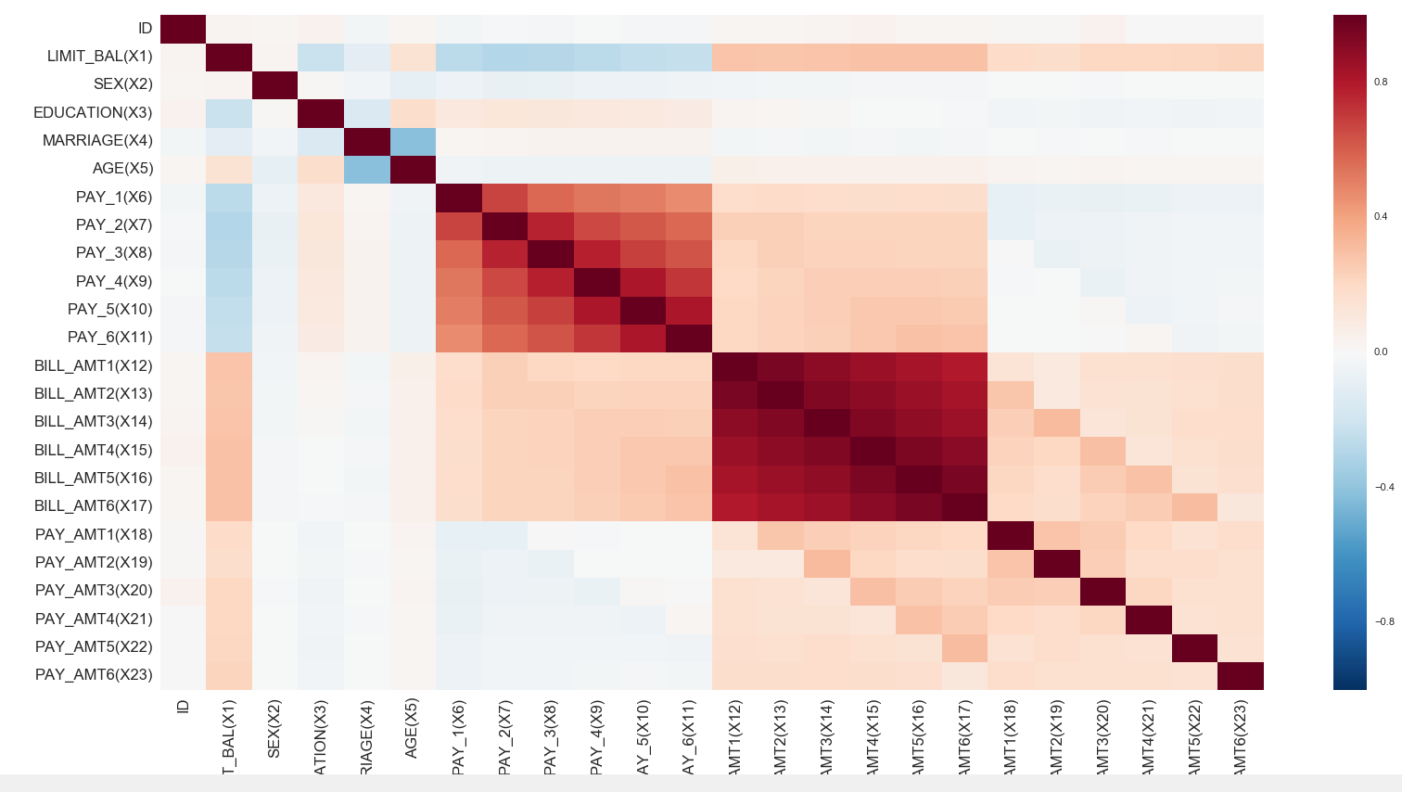
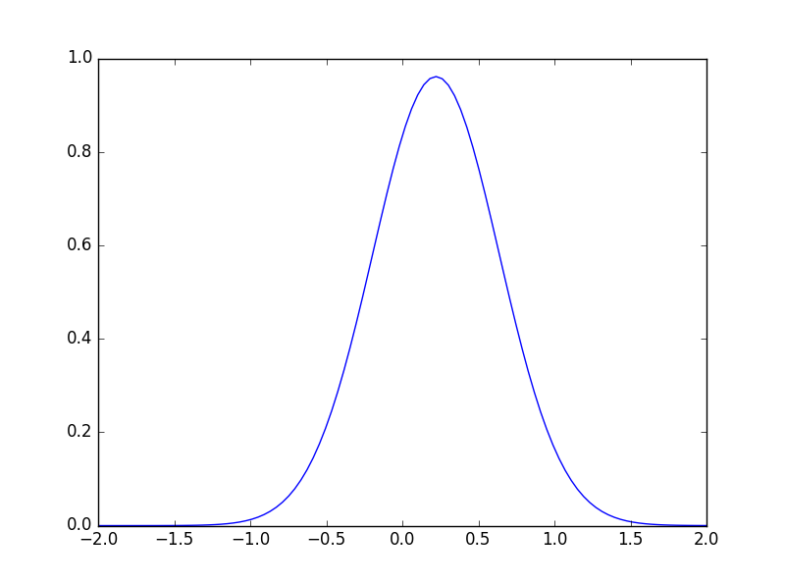
Data Exploration
All attributes have numeric set of values
The dataset is of the form (n>p) where n= number
of instances and p= number of attributes.
Skewness: 1.3435, thus it is right skewed.
Kurtosis: -0.19501, it represents a flatter distribution
compared to Gaussian distribution
Correlation Matrix of Data Set

Slide 11
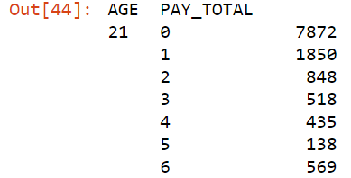
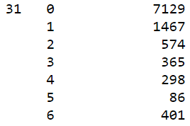
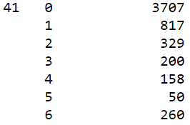
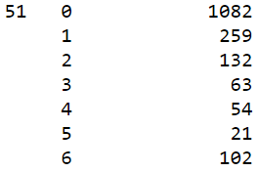
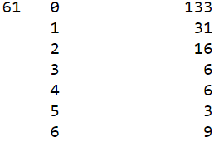
Data Exploration
A count of the number of defaults is generated against age groups
The younger age groups have been observed to default more than the other age groups.

Slide 12
Data Processing
The attribute name ‘PAY_0’ was converted to ‘PAY_1’ for naming convenience.
Numeric attributes were converted to nominal.
Values in the ‘EDUCATION’ variable was grouped such that the values ‘0,4,5,6’ was combined to one value and assigned a value ‘4’.
For all classification tasks, target variable was converted to numeric.

Slide 13
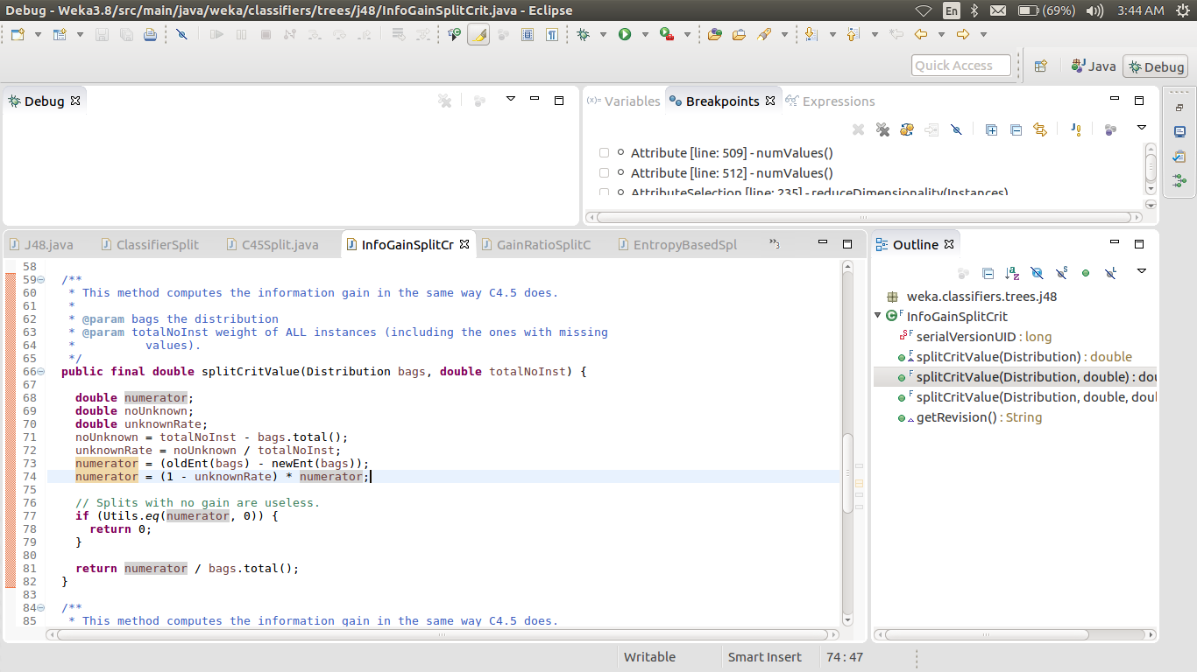
Weka Code Description (J4.8)
First, BuildTree Function is implemented
It checks whether instances belong to one class or not
Checks the basic parameters like whether the target is nominal
BuildClassifier function creates model for each attribute
For numeric data, Finds the best spit point, calculate Entropy
for each split and calculates the Information gain
Selects the best gain of all and define best split point
Info Gain= parent entropy – child entropy
Using best split point, split into subsets using Split function then recursively repeat the process
For Nominal data, it calculates the entropy for each class
InfoGain is calculated and Best gain value is selected
It checks whether the subsets have same classes and if not, recursively repeat. Else it’s a leaf node.

Slide 14
List of Resources
http://jmlr.org/proceedings/papers/v28/denil13-supp.pdf
Random Forests-Leo Breiman https://www.stat.berkeley.edu/~breiman/randomforest2001.pdf
An Introduction to Statistical Learning with applications in R - Trevor Hastie, Robert Tibshirani, Daniela Witten, Gareth James
Witten and Frank's textbook, Data Mining Practical Machine Learning Tools and Techniques

Slide 15
Business Understanding

Slide 16
Approach

Slide 17
Data Understanding

Slide 18
Summary of the Dataset

Slide 19
Exploratory Data Analysis

Slide 20
Exploratory Data Analysis

Slide 21
Data Visualisation

Slide 22
Data Preparation

